Slide 1
CAR PARKING- CSS ANIMATION
Thirupathi Gandla, saivivek therala

Slide 2
Problem Statement
We have created our own version of car parking using HTML and CSS.
This animation assumes parking to be done in a specified way.

Slide 3
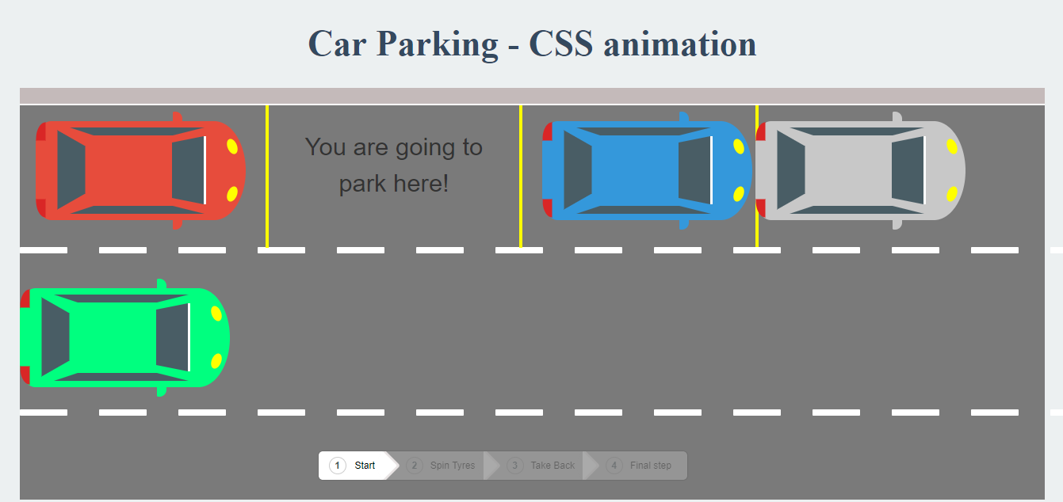
CAR PARKING

Slide 4
Key design features
Step wise Animation
Designing cars and street
Detailed car parking procedure
Easy navigation through breadcrumbs
Clean user interface

Slide 5
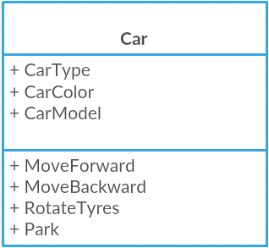
uml class diagram

Slide 6
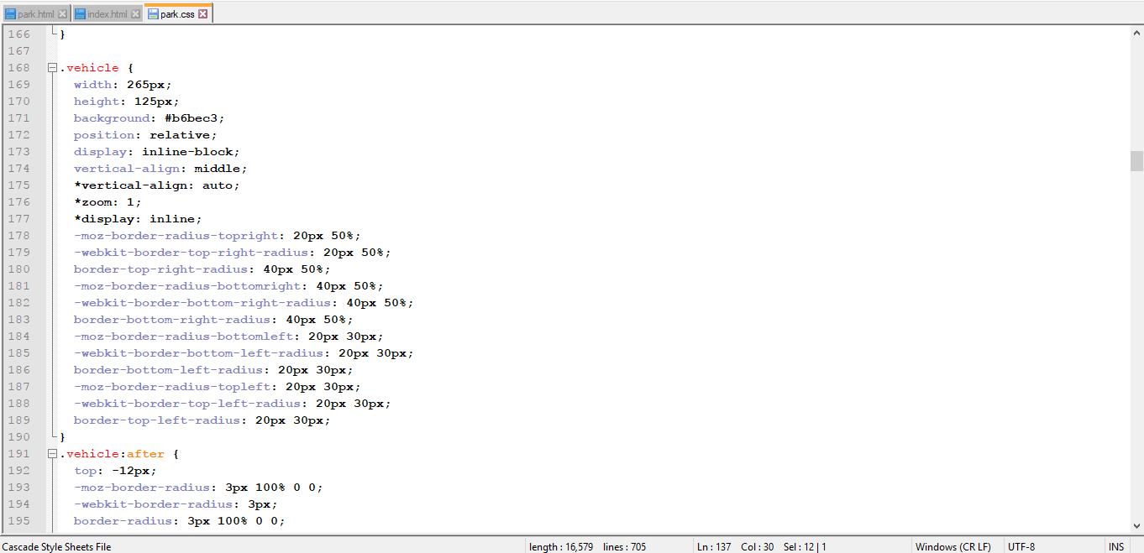
Css code for car

Slide 7
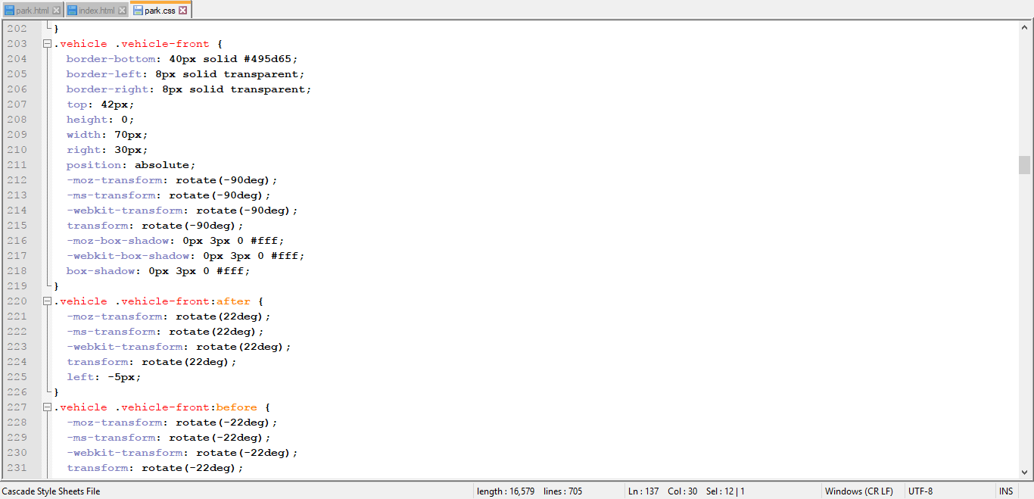
Car front

Slide 8
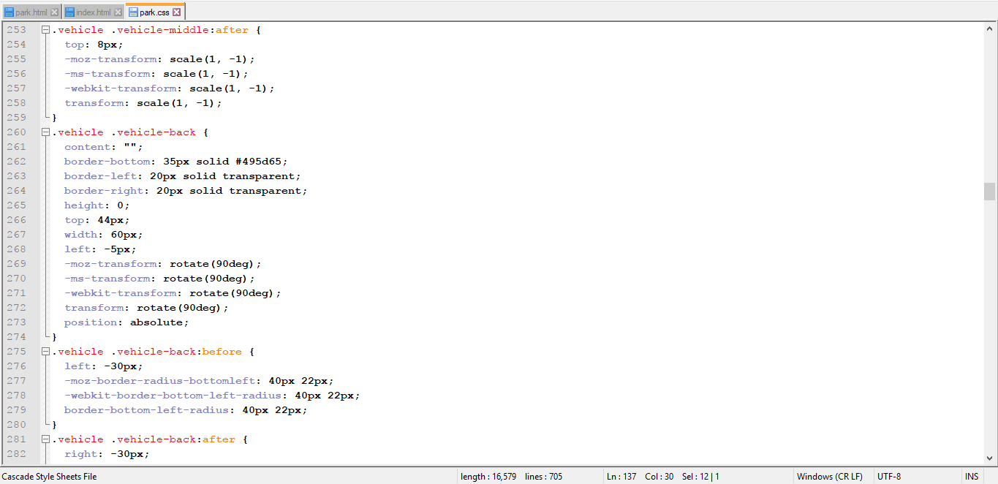
Car middle and back

Slide 9

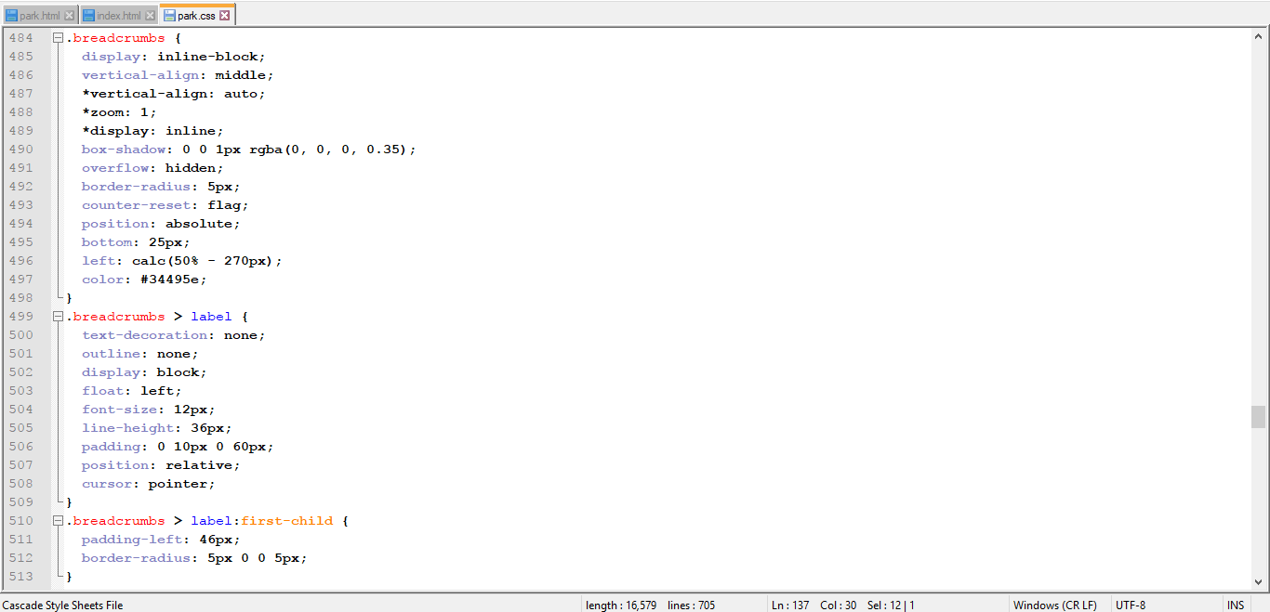
Breadcrumb navigation

Slide 10
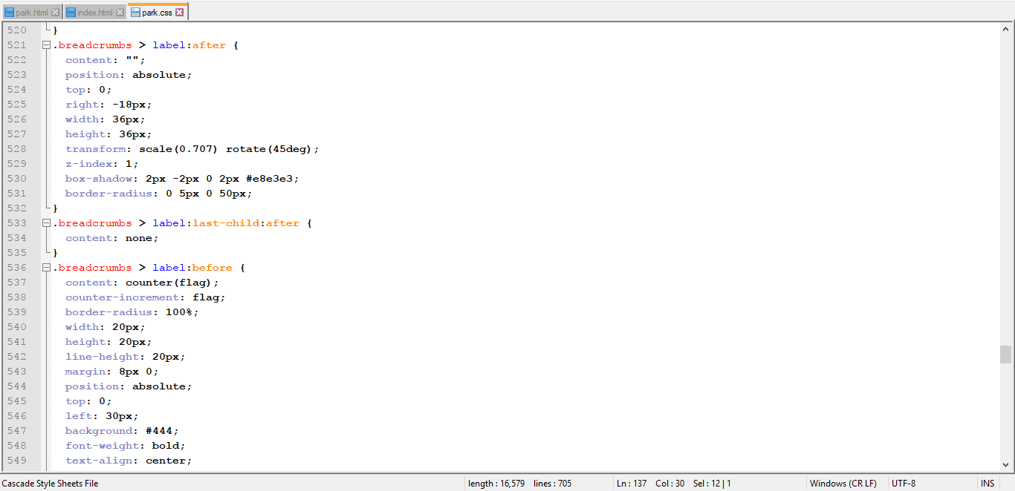
Breadcrumb navigation

Slide 11
Thank you..!!

